Slide 1
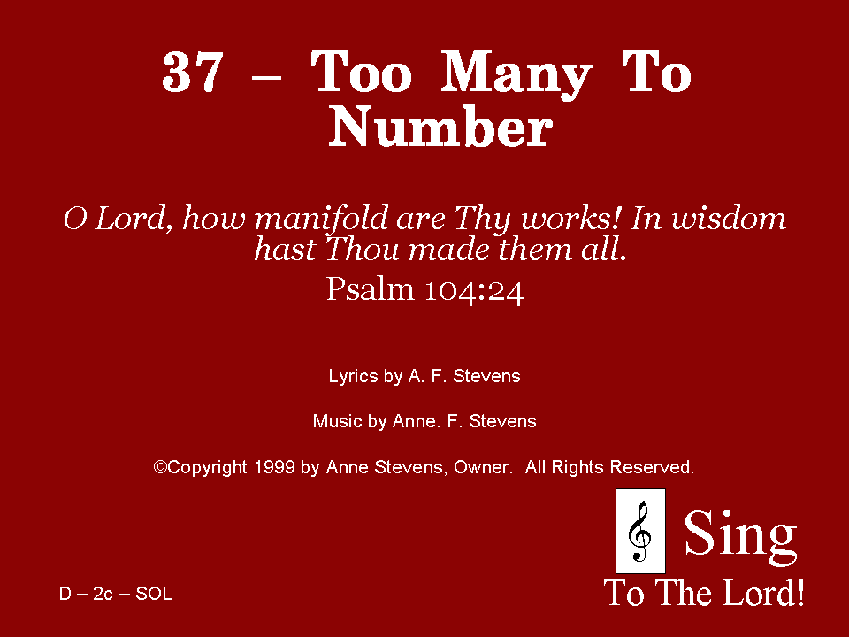
037 - Too Many To Number - Title

Slide 2
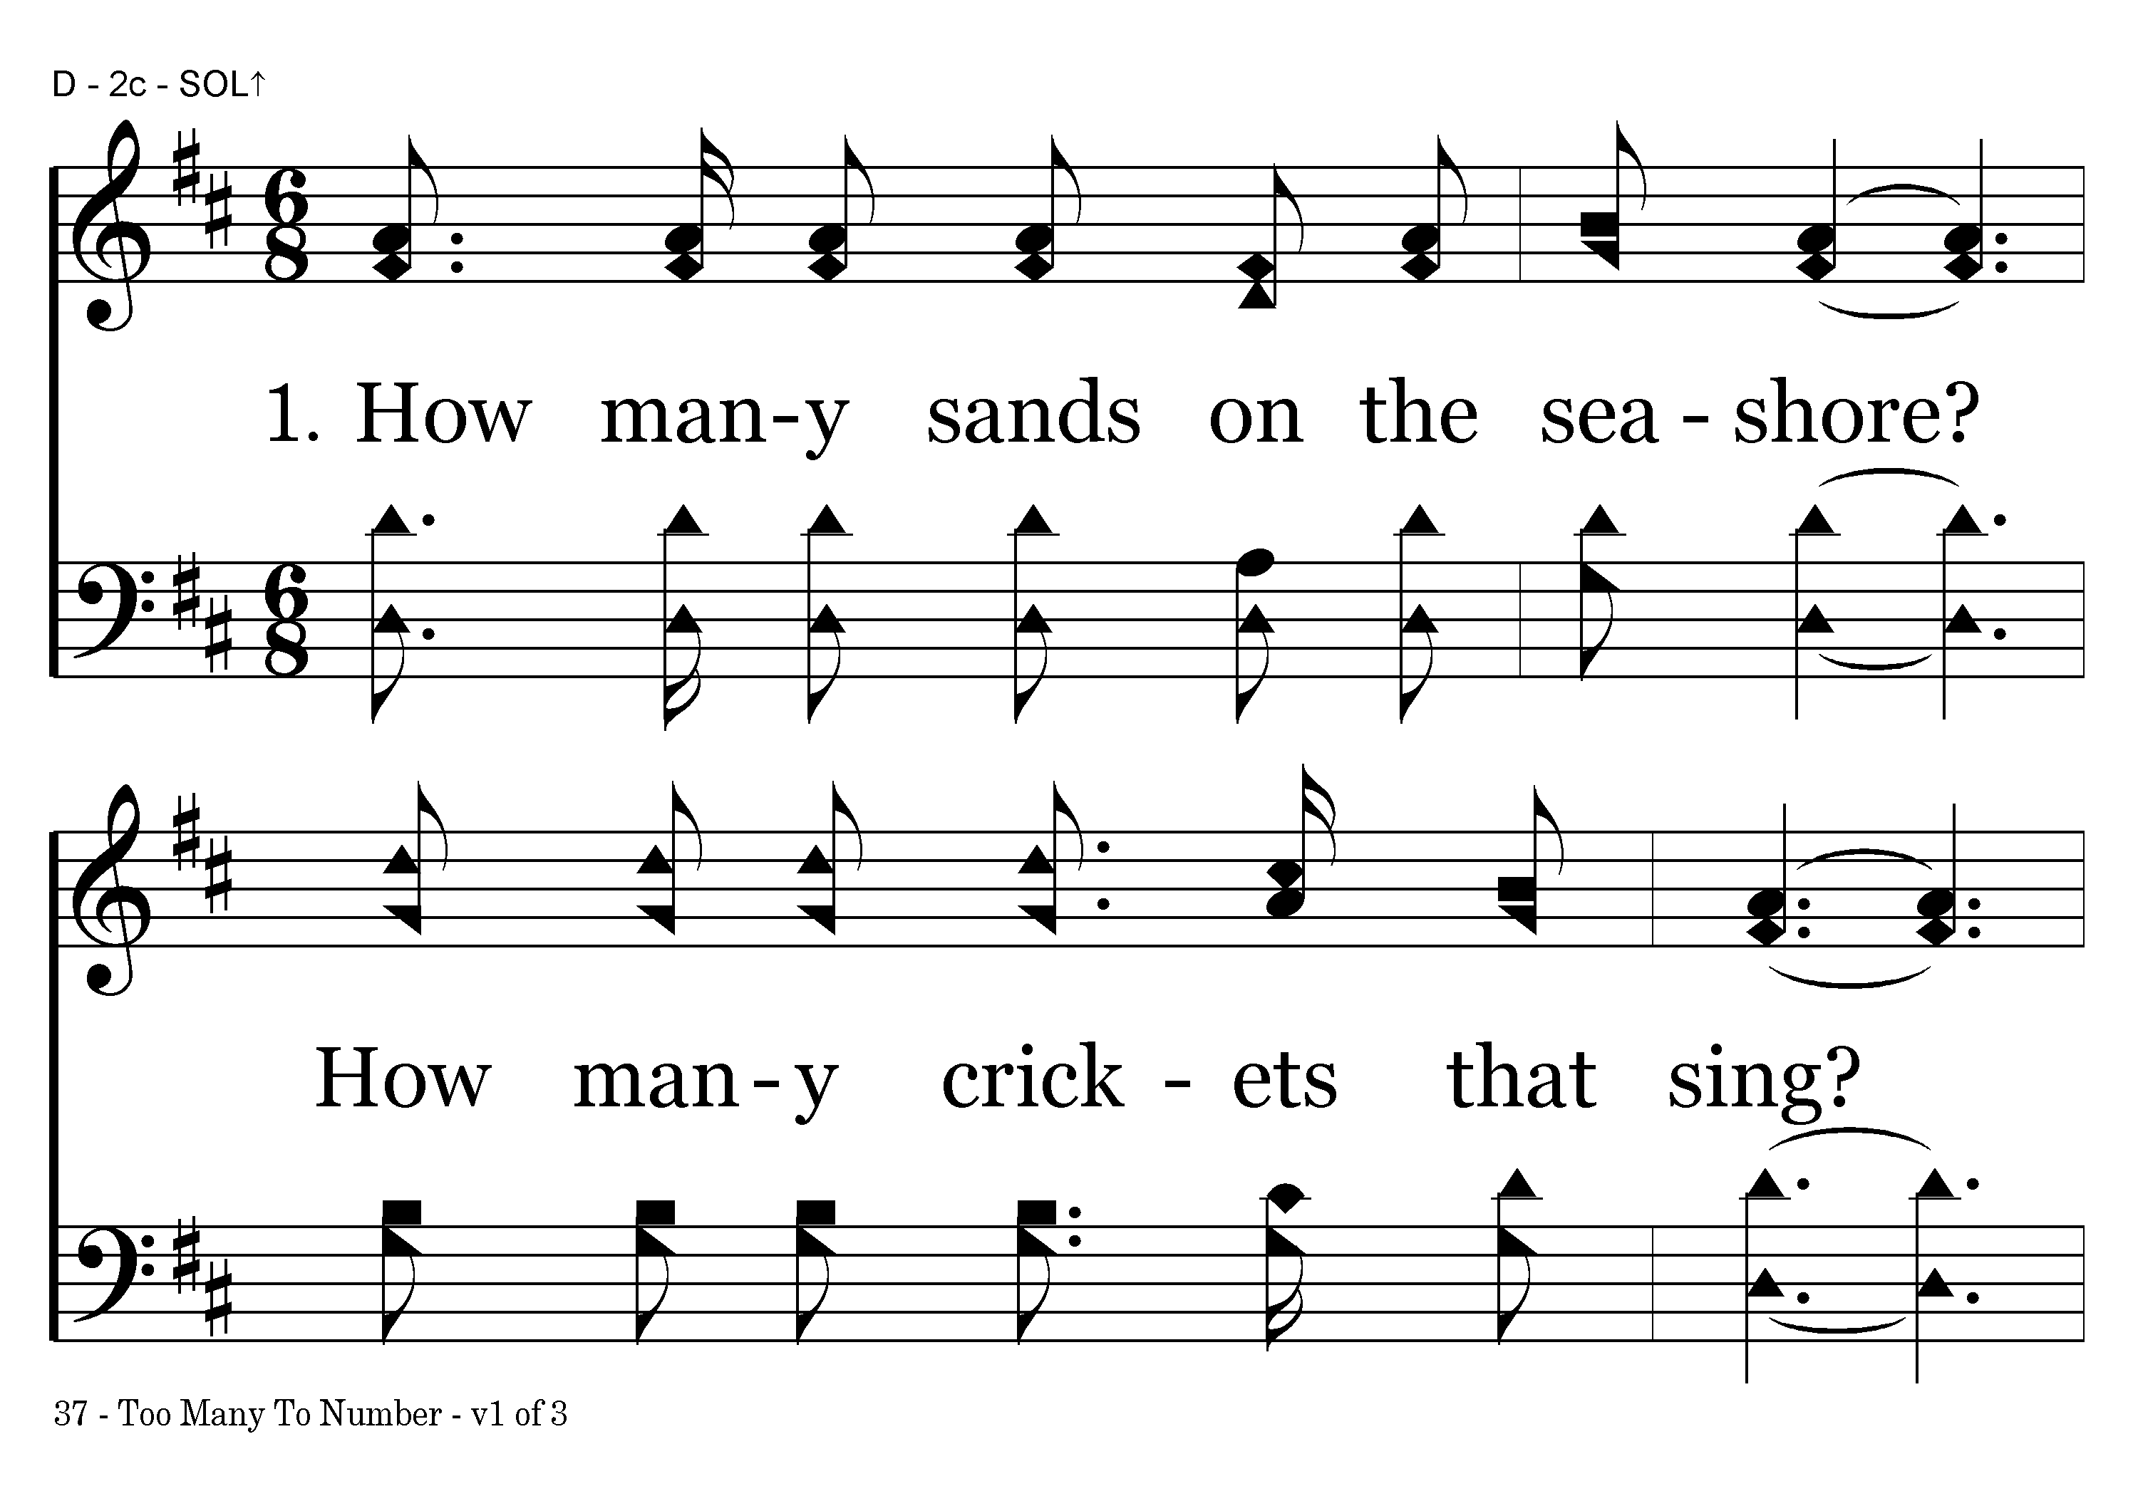
037 - Too Many To Number - 1.1

Slide 3
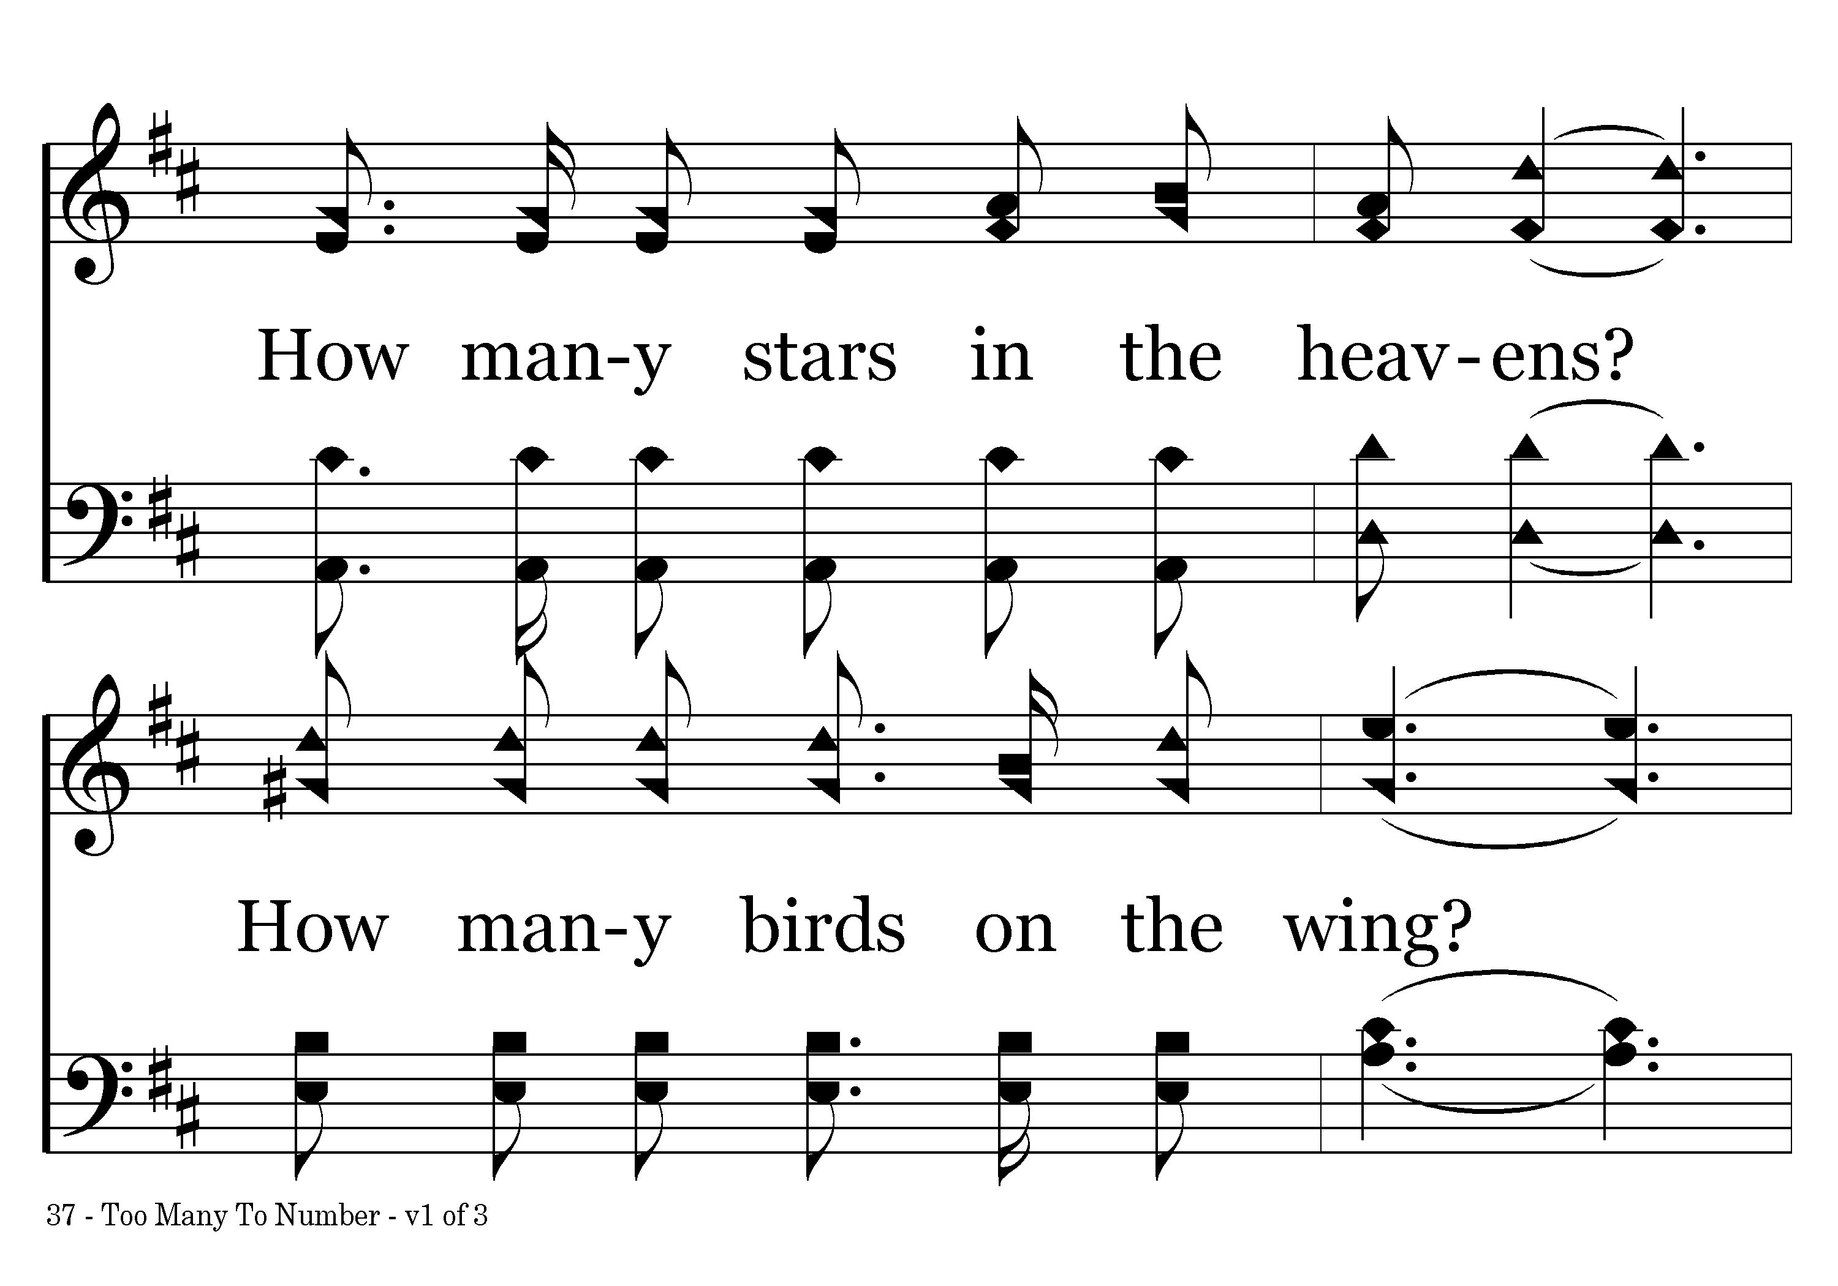
037 - Too Many To Number - 1.2

Slide 4
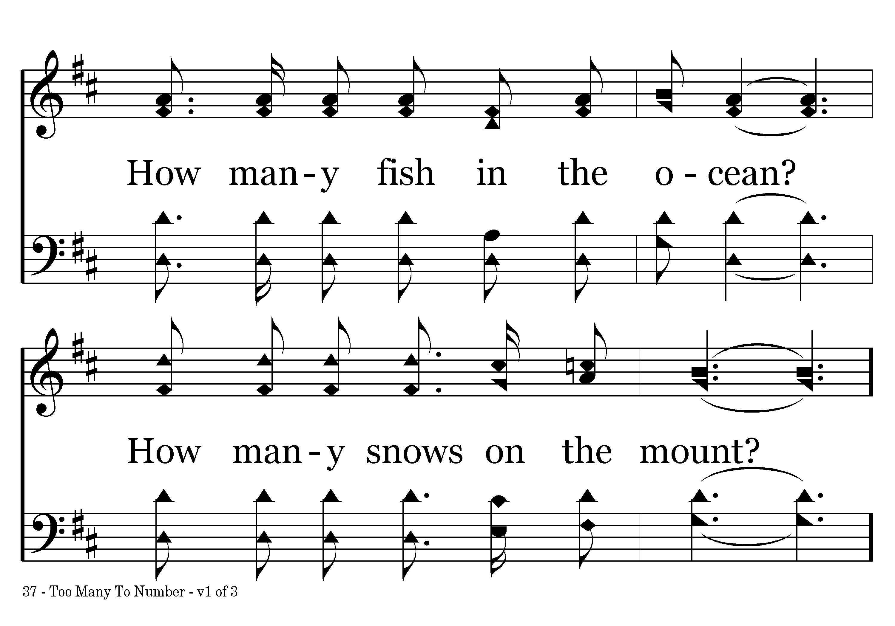
037 - Too Many To Number - 1.3

Slide 5
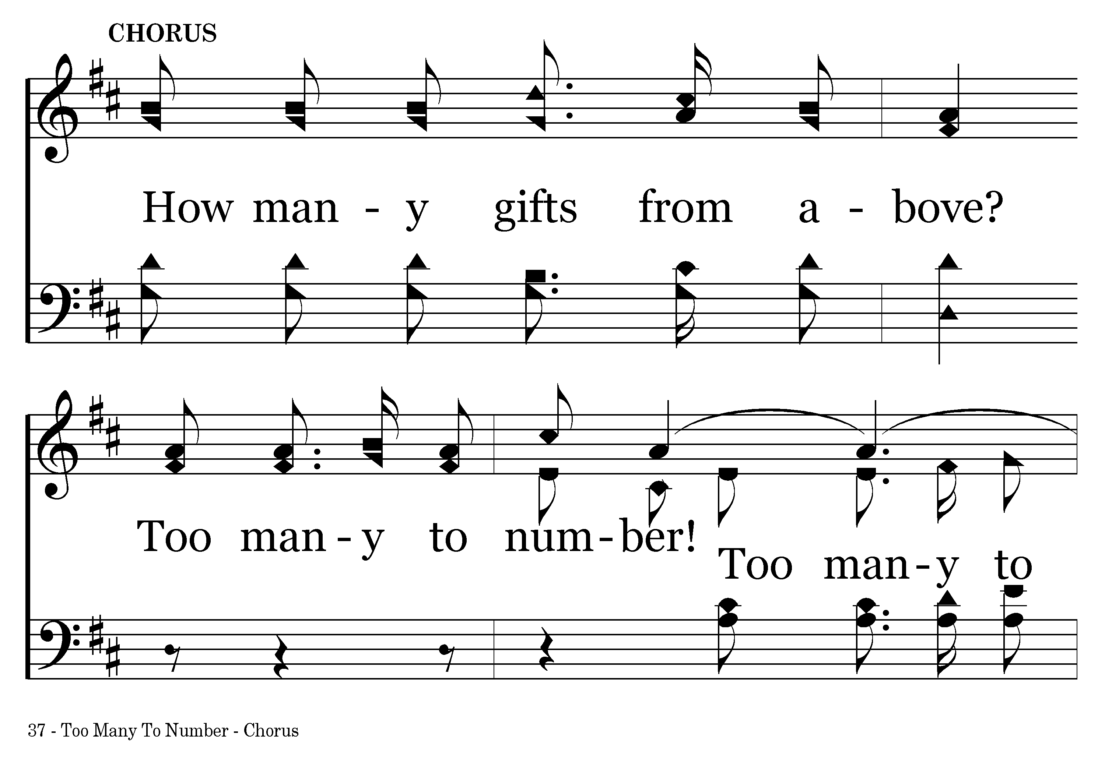
037 - Too Many To Number - C.1

Slide 6
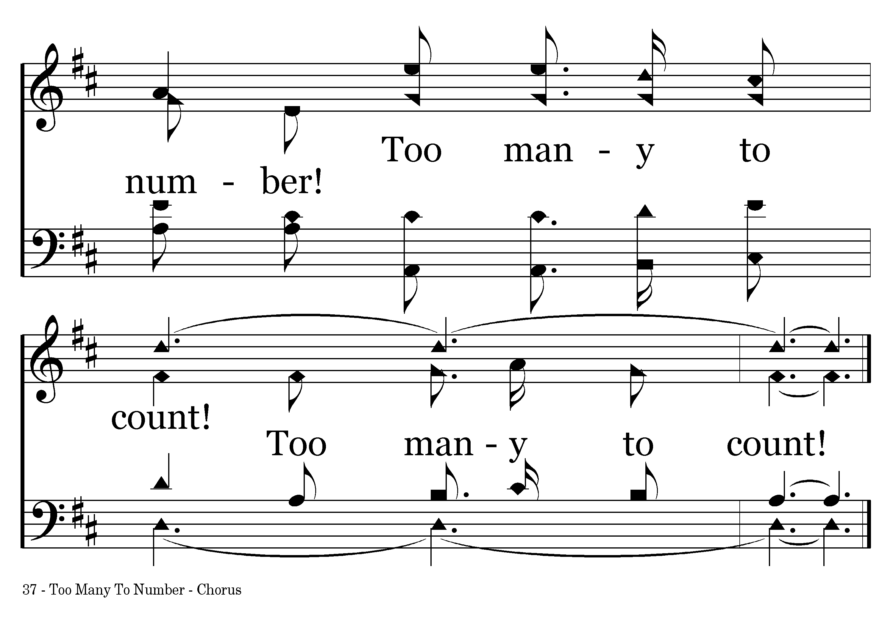
037 - Too Many To Number - C.2
End of Verse 1

Slide 7
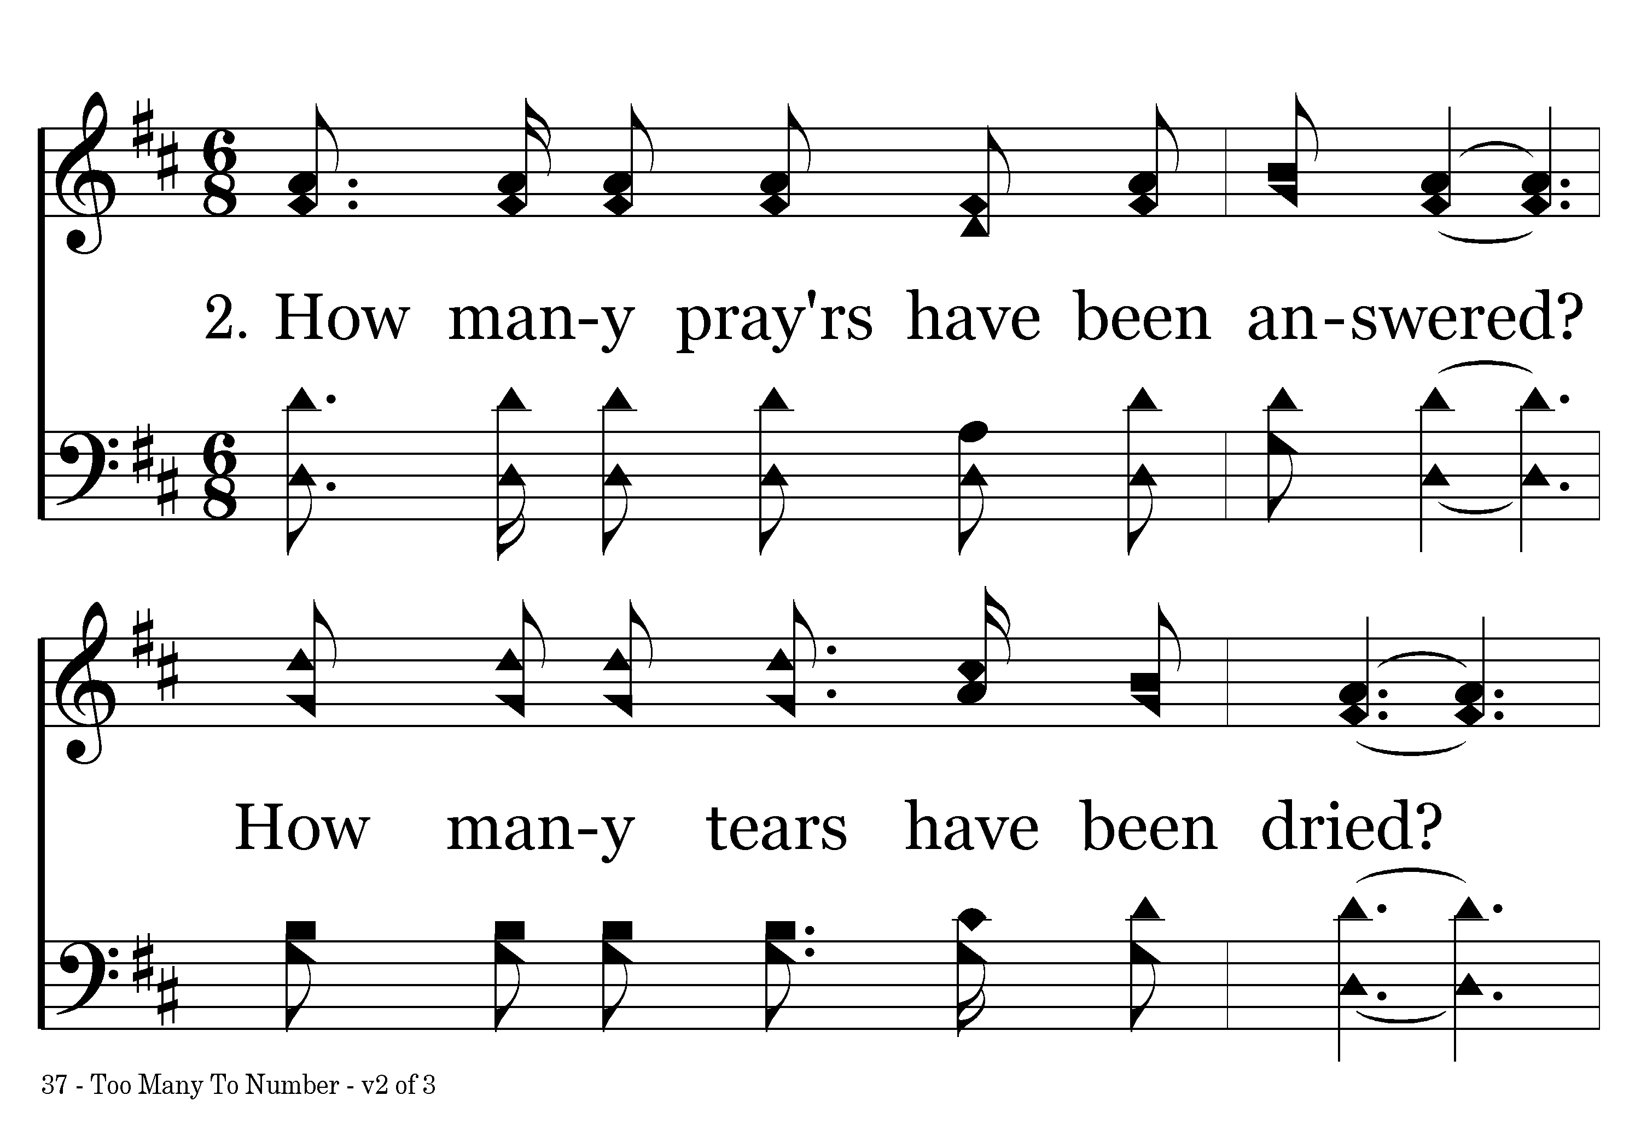
037 - Too Many To Number - 2.1

Slide 8
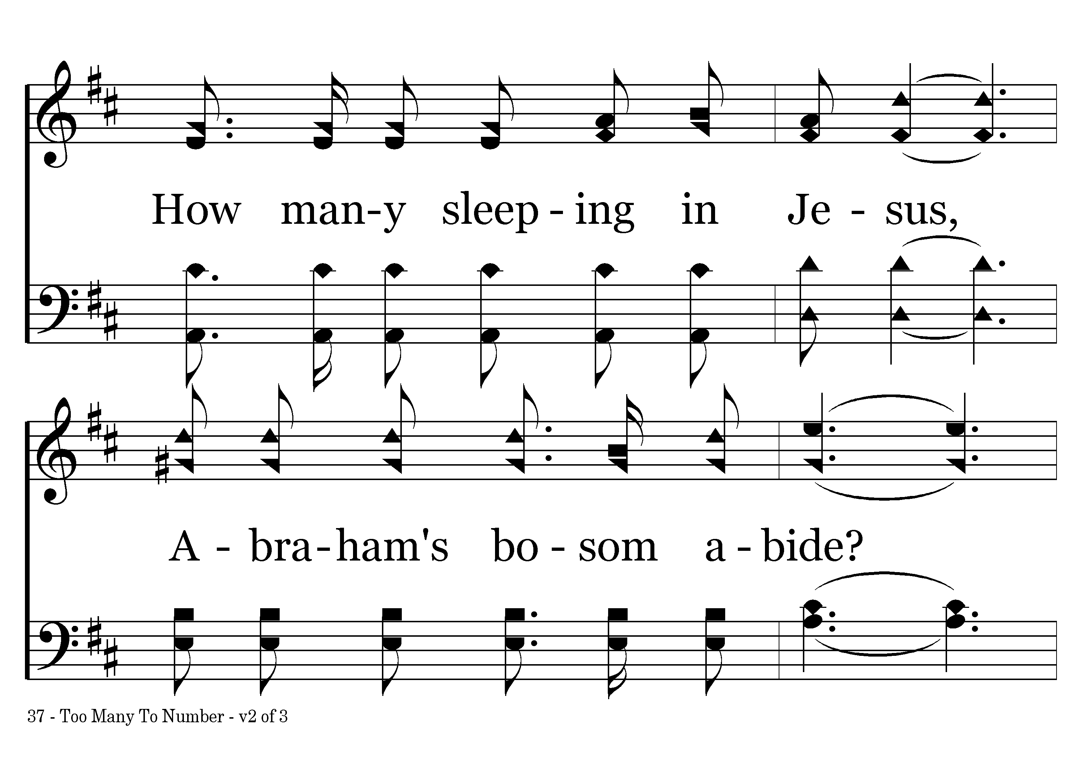
037 - Too Many To Number - 2.2

Slide 9
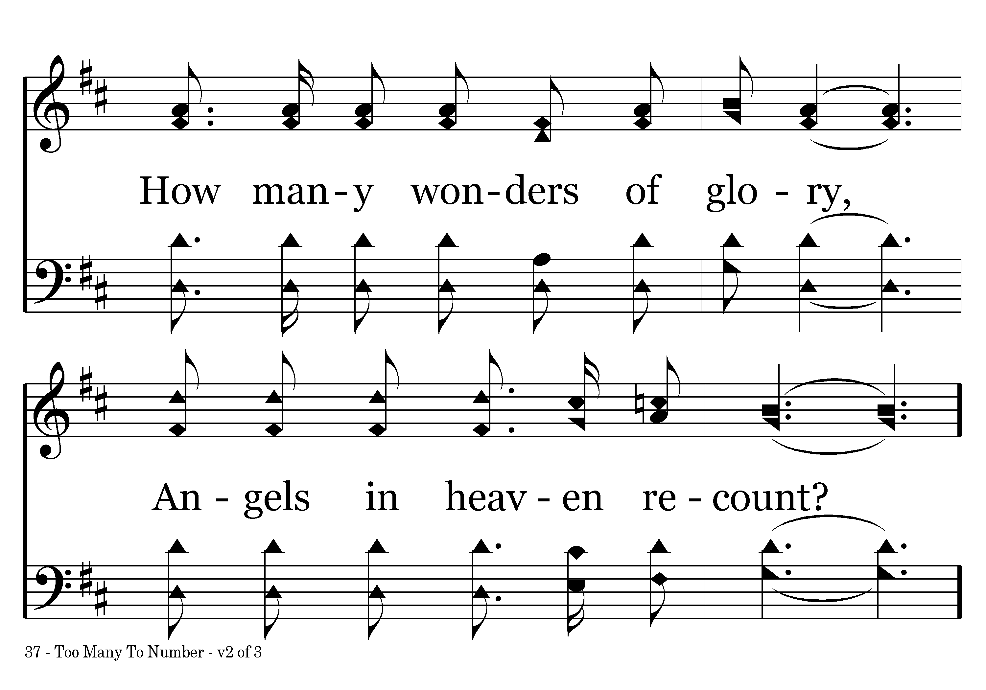
037 - Too Many To Number - 2.3

Slide 10
037 - Too Many To Number - C.1

Slide 11
037 - Too Many To Number - C.2
End of Verse 2

Slide 12
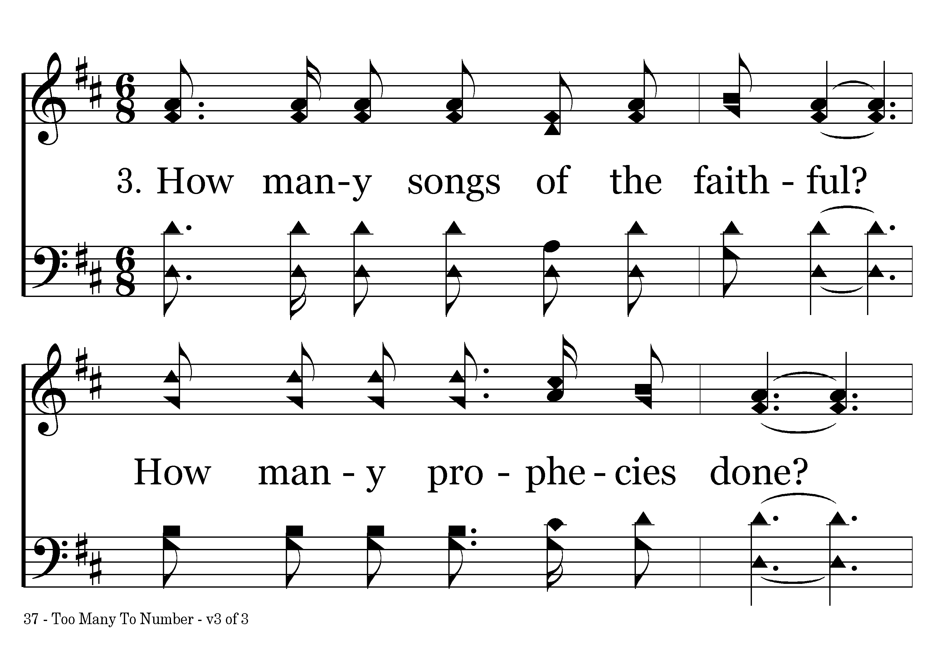
037 - Too Many To Number - 3.1

Slide 13
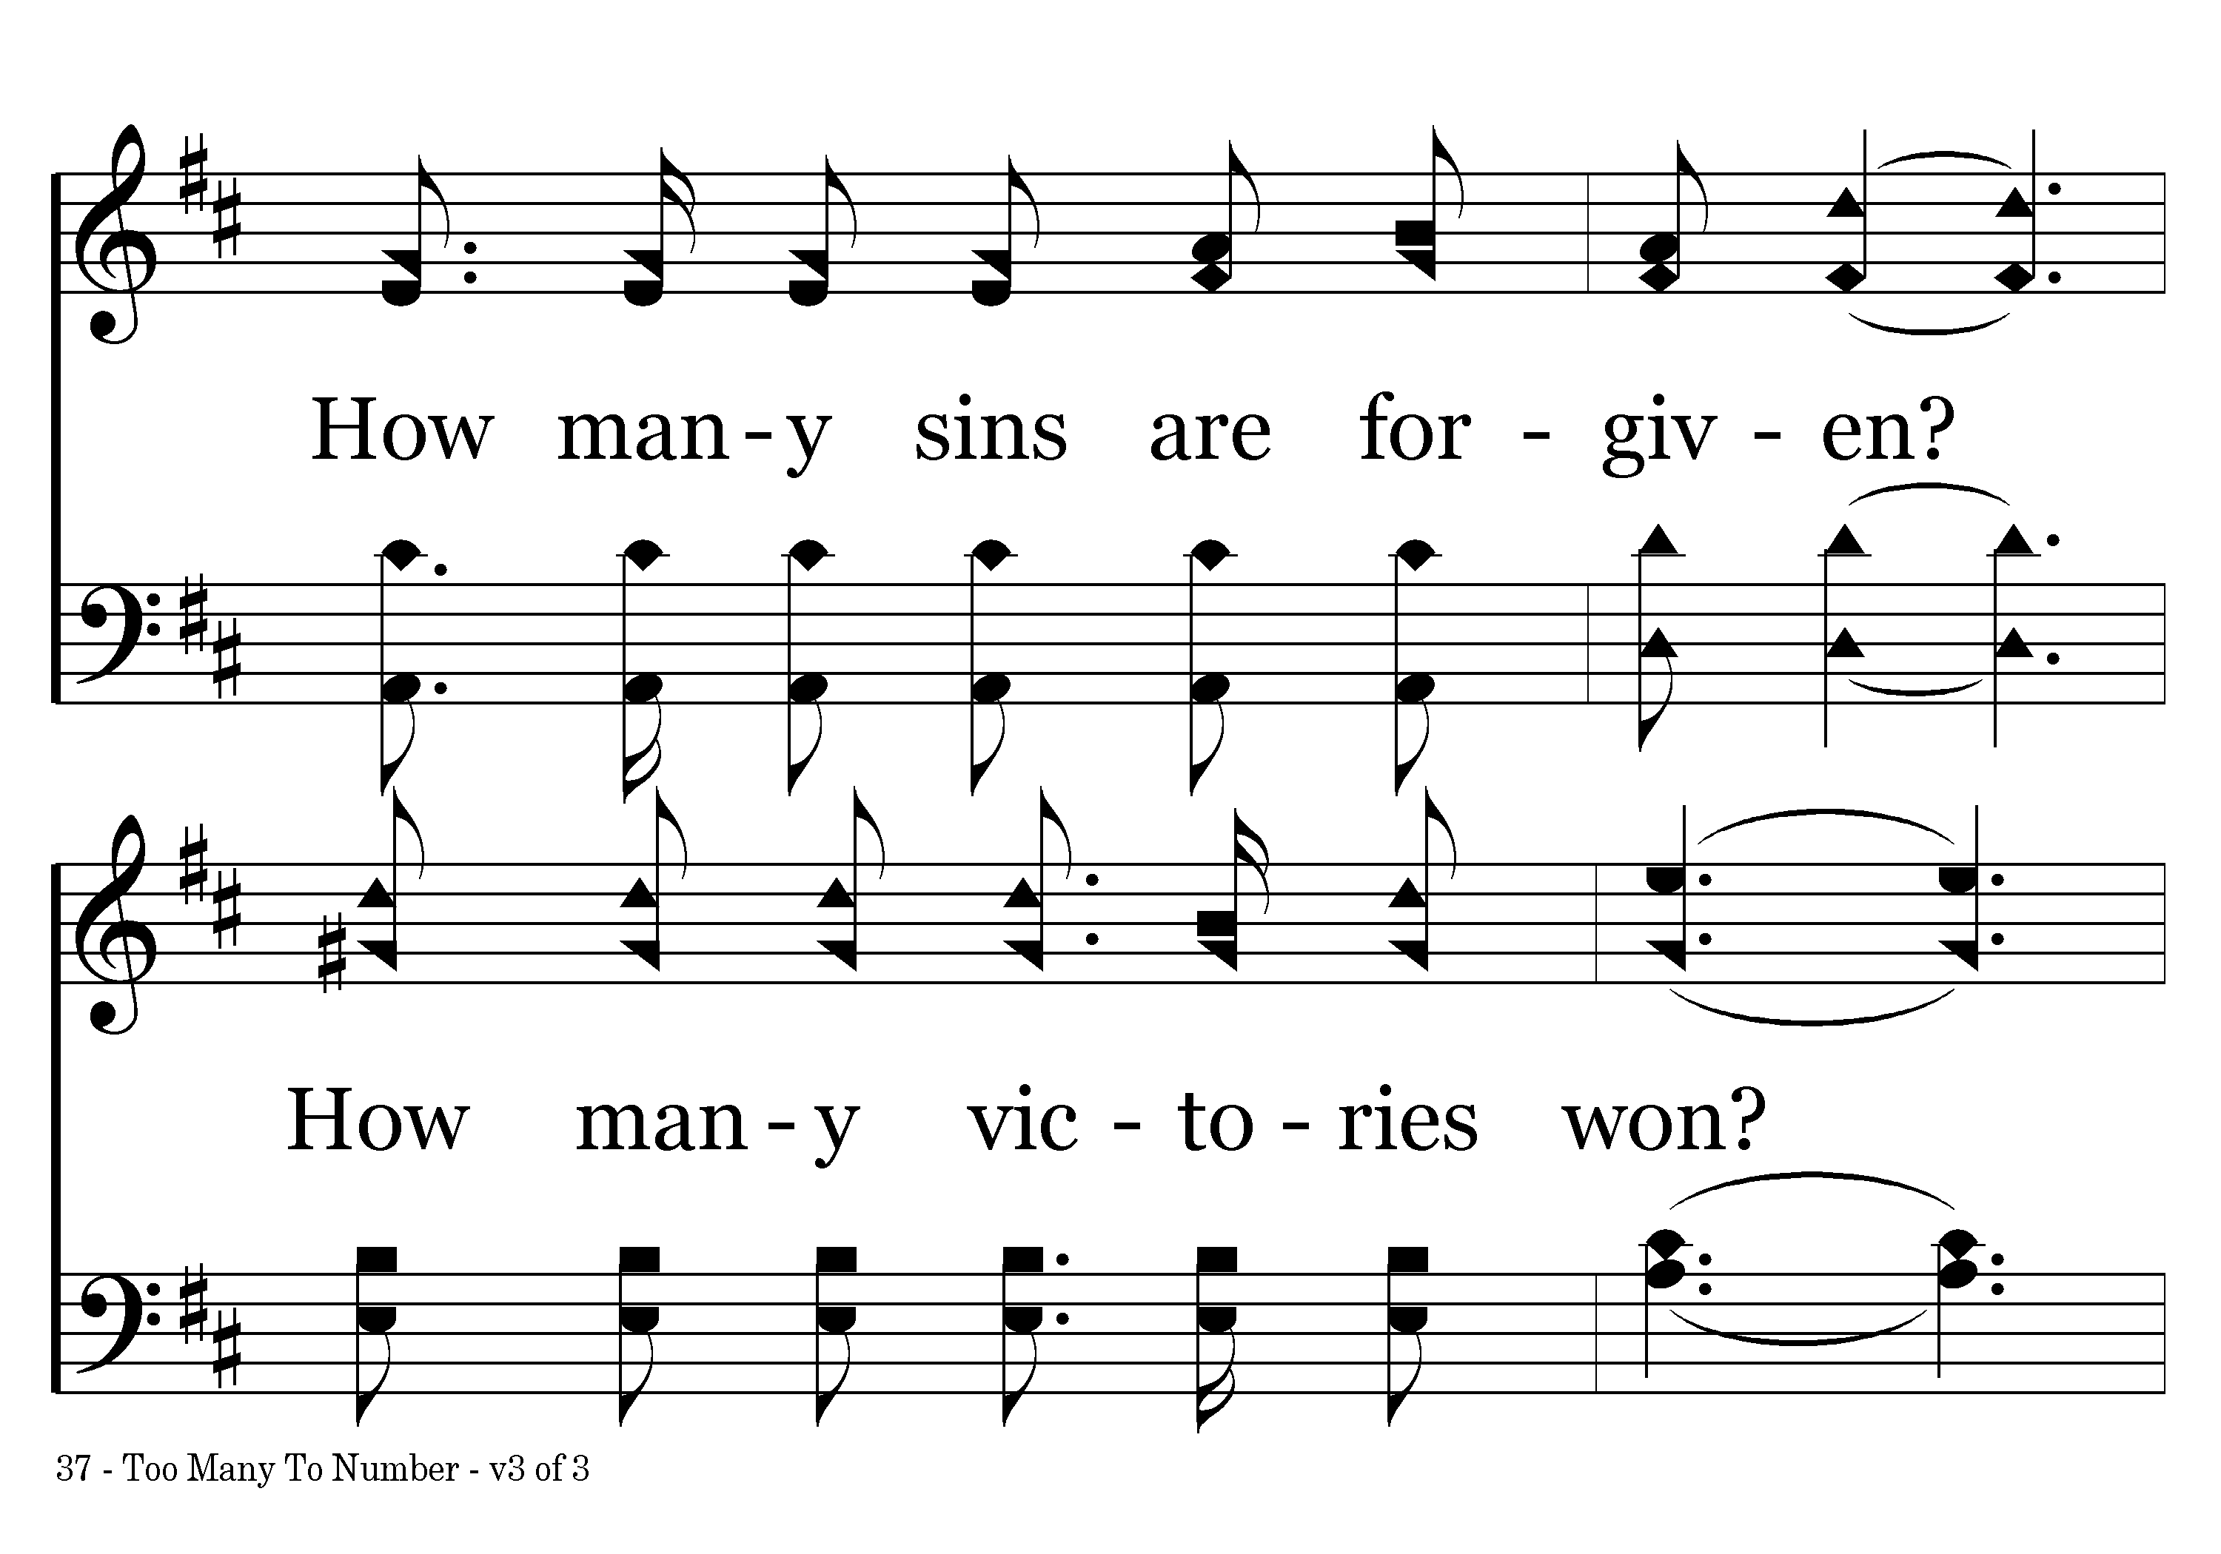
037 - Too Many To Number - 3.2

Slide 14
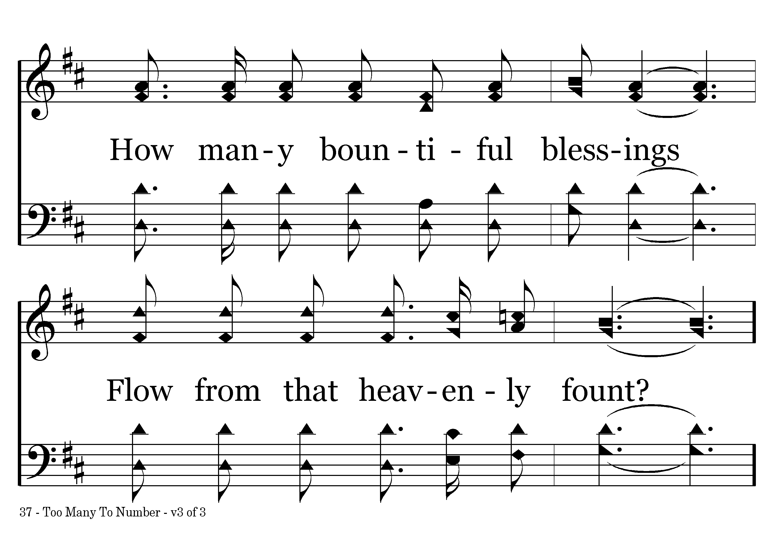
037 - Too Many To Number - 3.3

Slide 15
037 - Too Many To Number - C.1

Slide 16
037 - Too Many To Number - C.2
End of Song

